Slide 1
Applied Data Science
Covering physical modelling, statistical modelling, regression, signal processing, nonparametric statistics, image processing, machine learning, artificial intelligence, plotting, visualisation, probablistic methods, deep learning, neural networks, random forests, data munging, relational databases, object databases, very large files, high performance computing, scientific computing, text mining, text generation and knowledge engineering
@tleeuwenburg

Slide 2
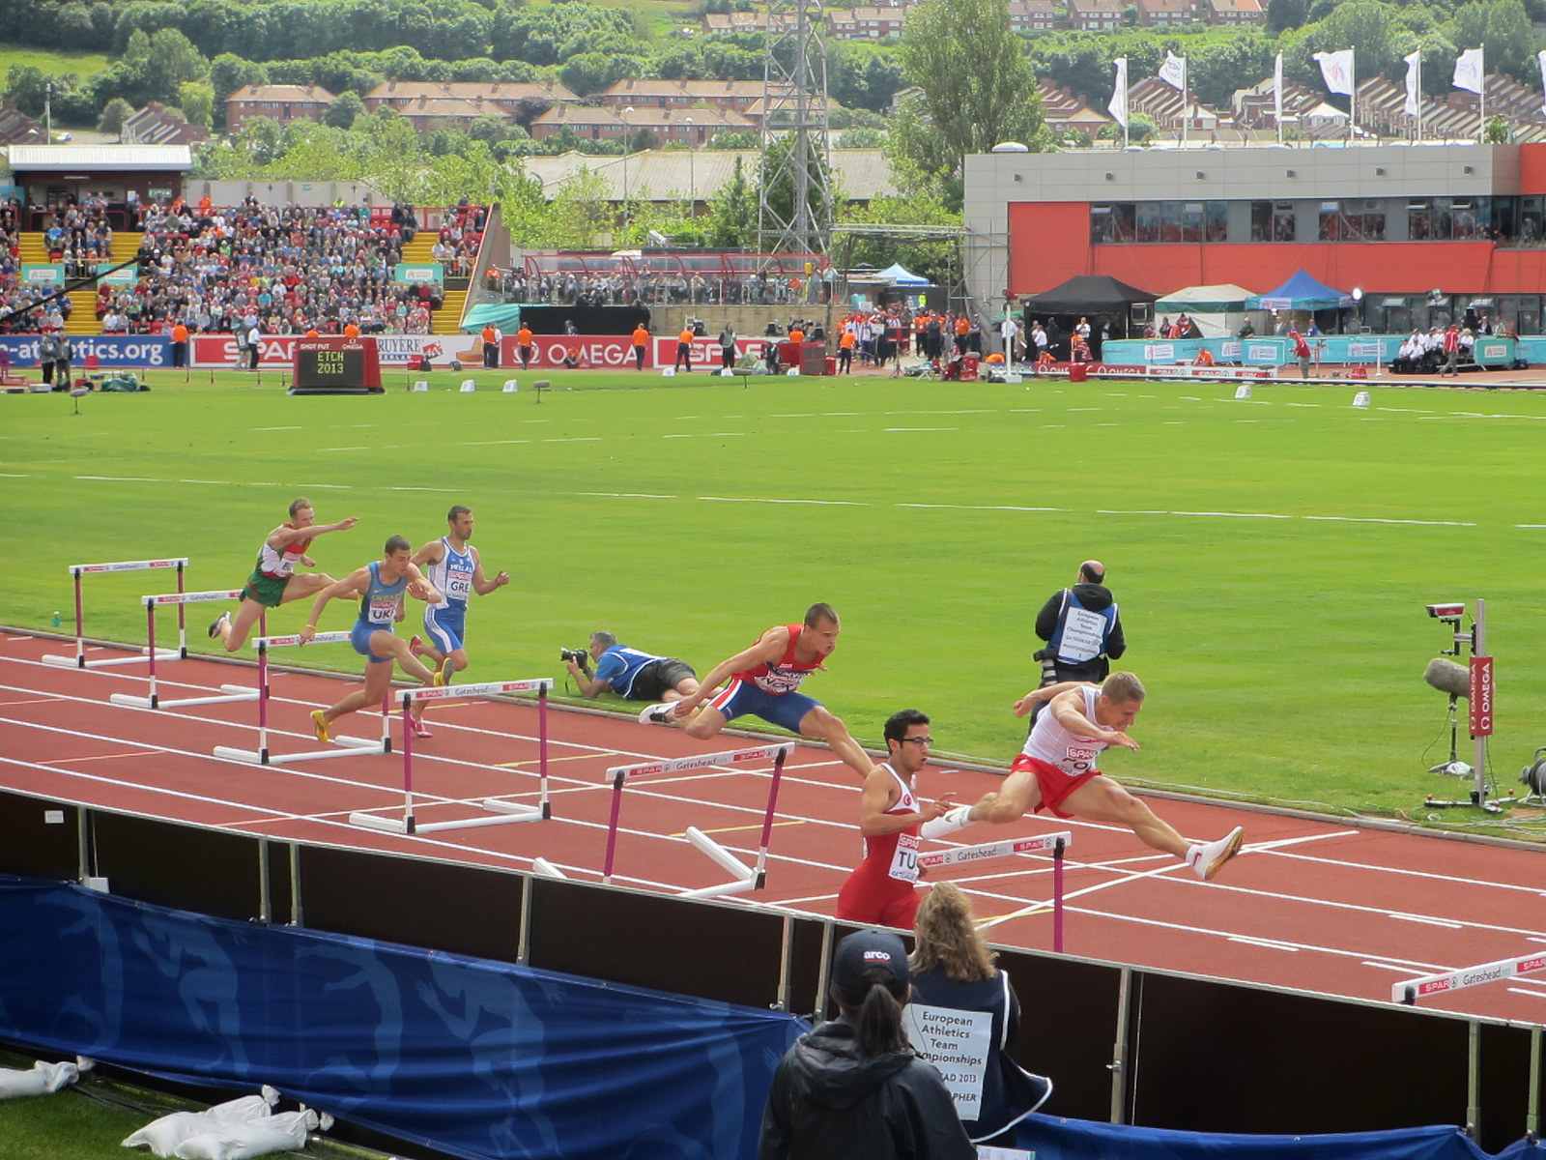
What Tutorials Are Like For Me
http://tinyurl.com/oypxd2x, @sandymillin, CC BY-NC 2.0

Slide 3
Se we’re going to spend 20 minutes on installing things… and then you can either do the exercises or just listen to the rest of the content

Slide 4
FIRST CLONE THIS REPO
https://github.com/tleeuwenburg/lca16
Or copy it from one of the USB keys (some additional data may be included on these)
INSTALL THE THINGS
try:
./install.sh
Except ScriptDidn’tWorkException:
Install Instructions: http://tinyurl.com/pqbwhpp
Except URLDidn’tWorkException:
Full url: http://myownhat.blogspot.com.au/ 2015/06/
setup-for-pycon-au-tutorial-take-one.html

Slide 5
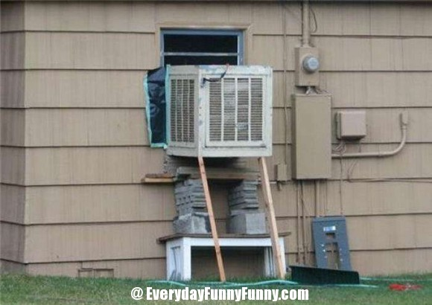
Still broken? Fix it yourself ☹

Slide 6
Recent News
Nov 2015: Google releases TensorFlow
Dec 2016: OpenAI nonprofit research institute
Jan 2016: Google releases free Udacity course
Jan 2016: Baidu releases “Fast CTC”
The world is moving fast, but things are also getting easier to do
A lot of bold claims are made about AI…

Slide 7
The AI Apocalypse
“I think we should be very careful about artificial intelligence. If I had to guess at what our biggest existential threat is, it’s probably that. So we need to be very careful.”
Elon Musk
http://www.theguardian.com/technology/2014/oct/27/elon-musk-artificial-intelligence-ai-biggest-existential-threat

Slide 8
The Cutting Edge
“There’s a big difference between intelligence and sentience. There could be a race of killer robots in the far future, but I don’t work on not turning AI evil today for the same reason I don’t worry about the problem of overpopulation on the planet Mars.”
Andrew Ng
http://www.theregister.co.uk/2015/03/19/andrew_ng_baidu_ai/

Slide 9
Spreadsheets
☹

Slide 10
Emerging Convergence of Paradigms
Vector and matrix data representation
Networked-array based information models
Convergence between image processing, text processing and statistical modelling
Physical modelling going its own separate way (more fundamental? Coming soon?)
Random forest; gradient boosting; convolutional networks; vector-based conceptual representation; deep learning

Slide 11
Limitations and Bumps
Practical / data-munging: Handling poor data
Physical modelling and identifying causation
Machine Learning-Learning Techniques
Hypothesis Testing
Induction and deduction beyond correlation
Things just inexplicably don’t work sometimes
Adversarial examples challenge our ideas

Slide 12
Tech Grab Bag
Python 3 (no risk of integer division)
Word2Vec, keras, sklearn (note – keras sits on top of Theano / tensorflow, is easier)
Neural nets: Convolutional Networks, Recurrent Networks, Deep Networks
Other networks: random forests (decision trees), bayes networks, gradient boosting
Data preprocessing: augmentation, normalisation, feature extraction

Slide 13
Reproducing significant results
Divided up into two practicals:
Mnist Digit Recognition (Random Forest)
Word2Vec (Neural Net)
Followed by discussion:
Validation, verification / Visualisation, attribution
If time allows: BYOD (bring your own data)

Slide 14
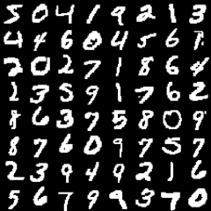
Session One -- Images
Image source: http://www.opendeep.org/docs/tutorial-classifying-handwritten-mnist-images

Slide 15
Breaking Down The Theory
Priming the Intuition:
Decision Tree: intuitive, effective sometimes
Random Forests: ensembles are good
Neural Networks: good but explode randomly
Convolutional Networks: inherent structure
Word Vectorisation: suprising!

Slide 16
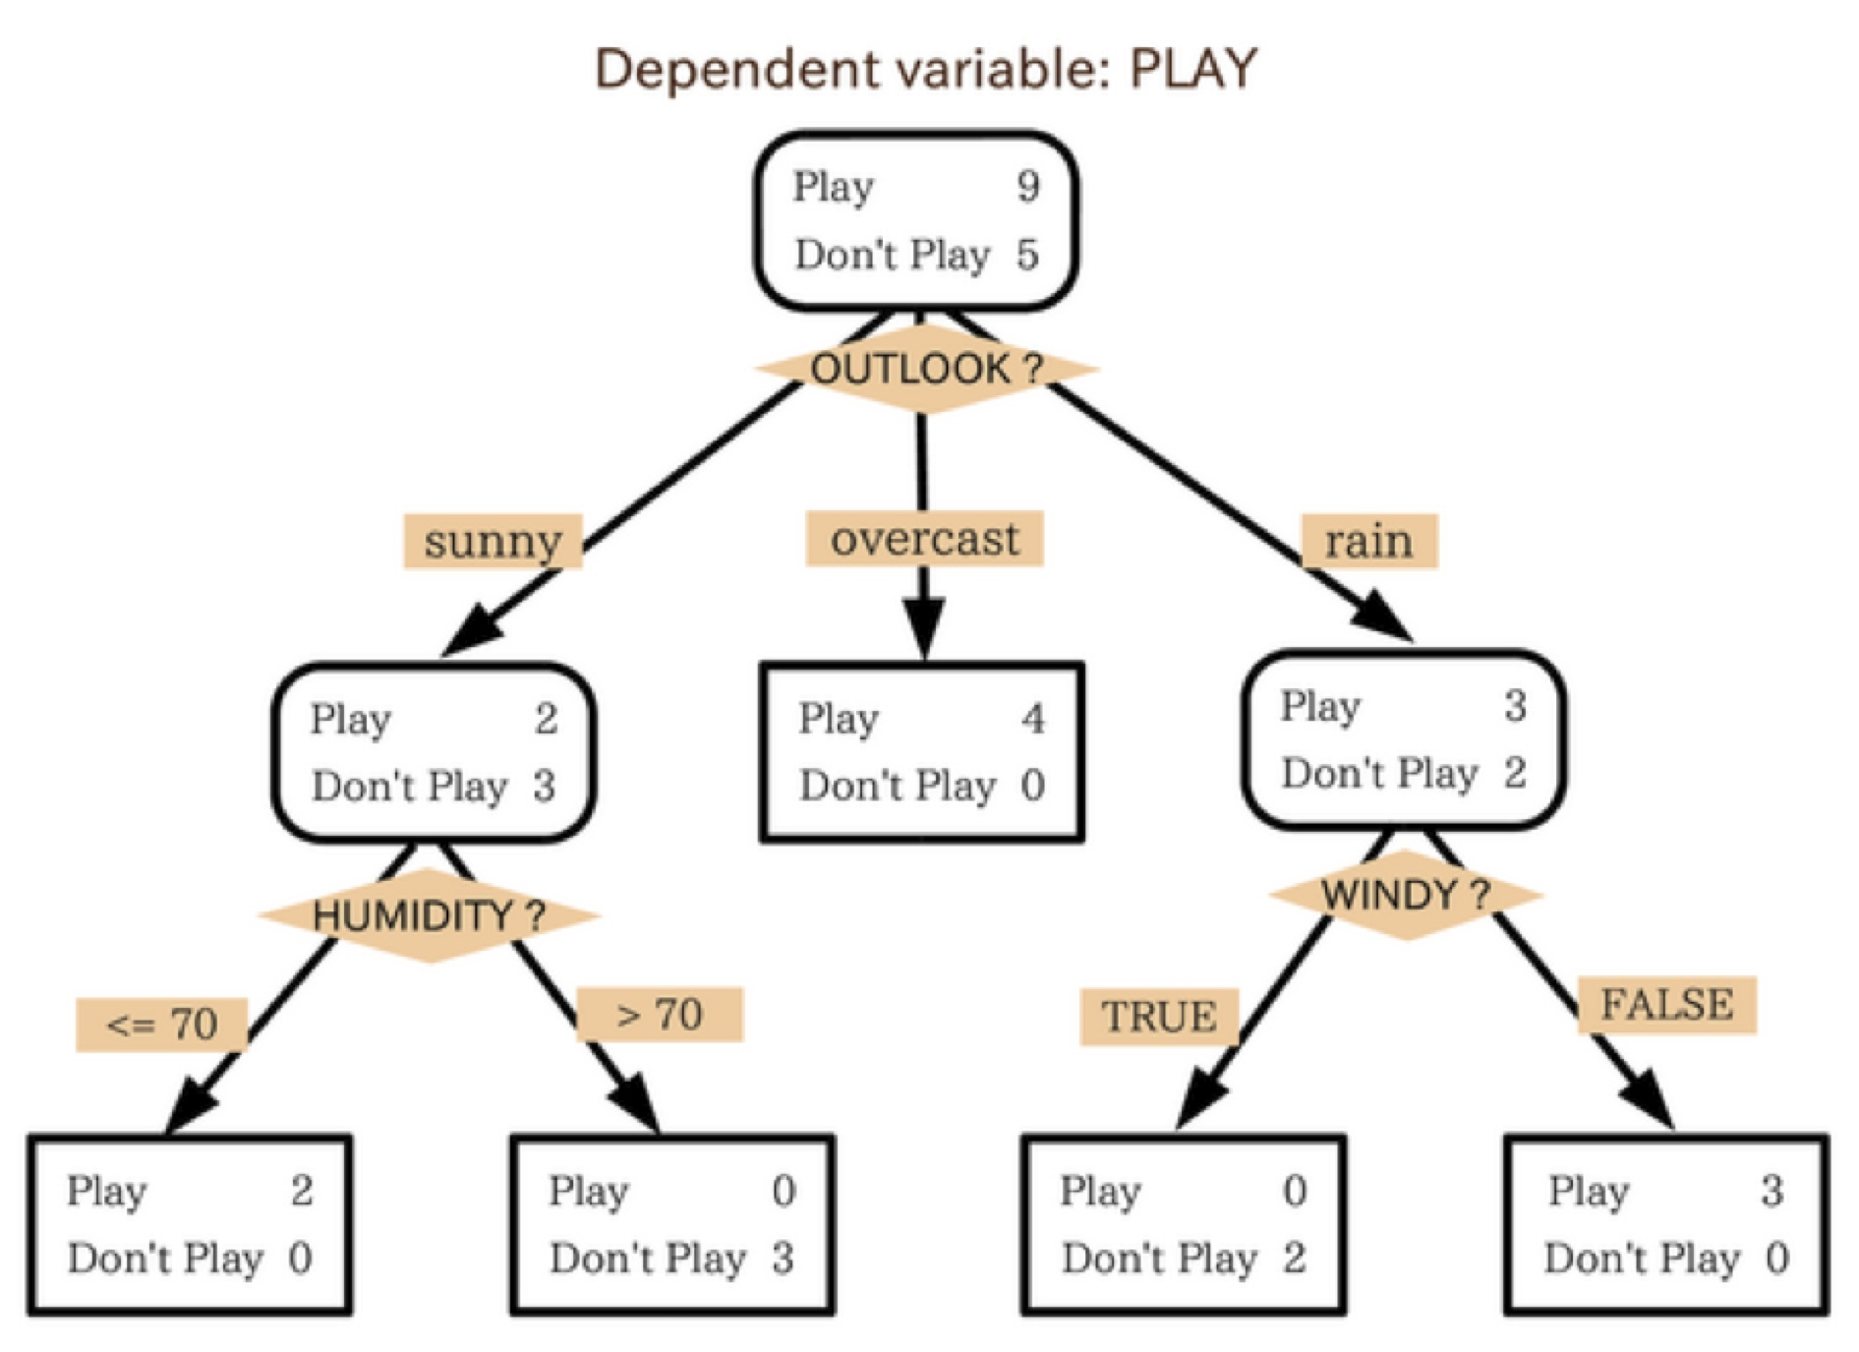
What is a Decision Tree
Source: https://citizennet.com/blog/2012/11/10/random-forests-ensembles-and-performance-metrics/

Slide 17
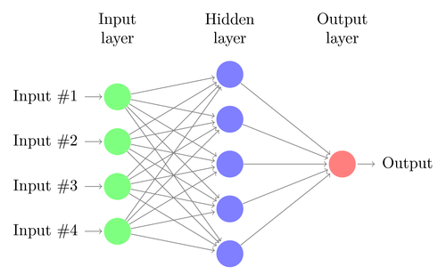
Basic Neural Net
Image source: http://www.texample.net/tikz/examples/neural-network/ CC-BY-2.5

Slide 18
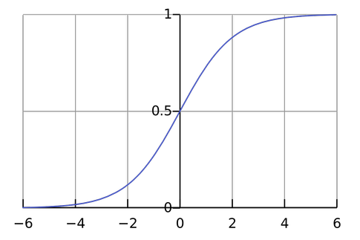
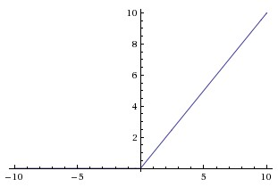
Activation Functions
SoftMax Activation
Linear Rectifier Unit
Image source: http://www.quora.com/What-is-the-significance-of-the-softmax-function
Image source: http://cs231n.github.io/neural-networks-1/

Slide 19
Hands-On Examples
source activate <path to environment>
Ipython notebook
Go look at the MNIST directory

Slide 20
Testing Predictions
How do you know if you something is right?
Especially if you’re a sceptical person…
Worked on my machine
“Seems okay”
About as good as a weather forecast
As good as X within Y% likelihood
Accounts for Z% of the error

Slide 21
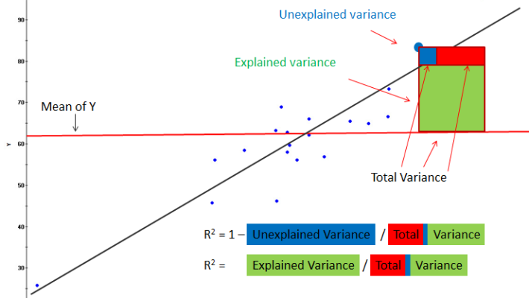
Percent Explained (R2)
Source: http://www.rapidinsightinc.com/brushing-r-squared/

Slide 22
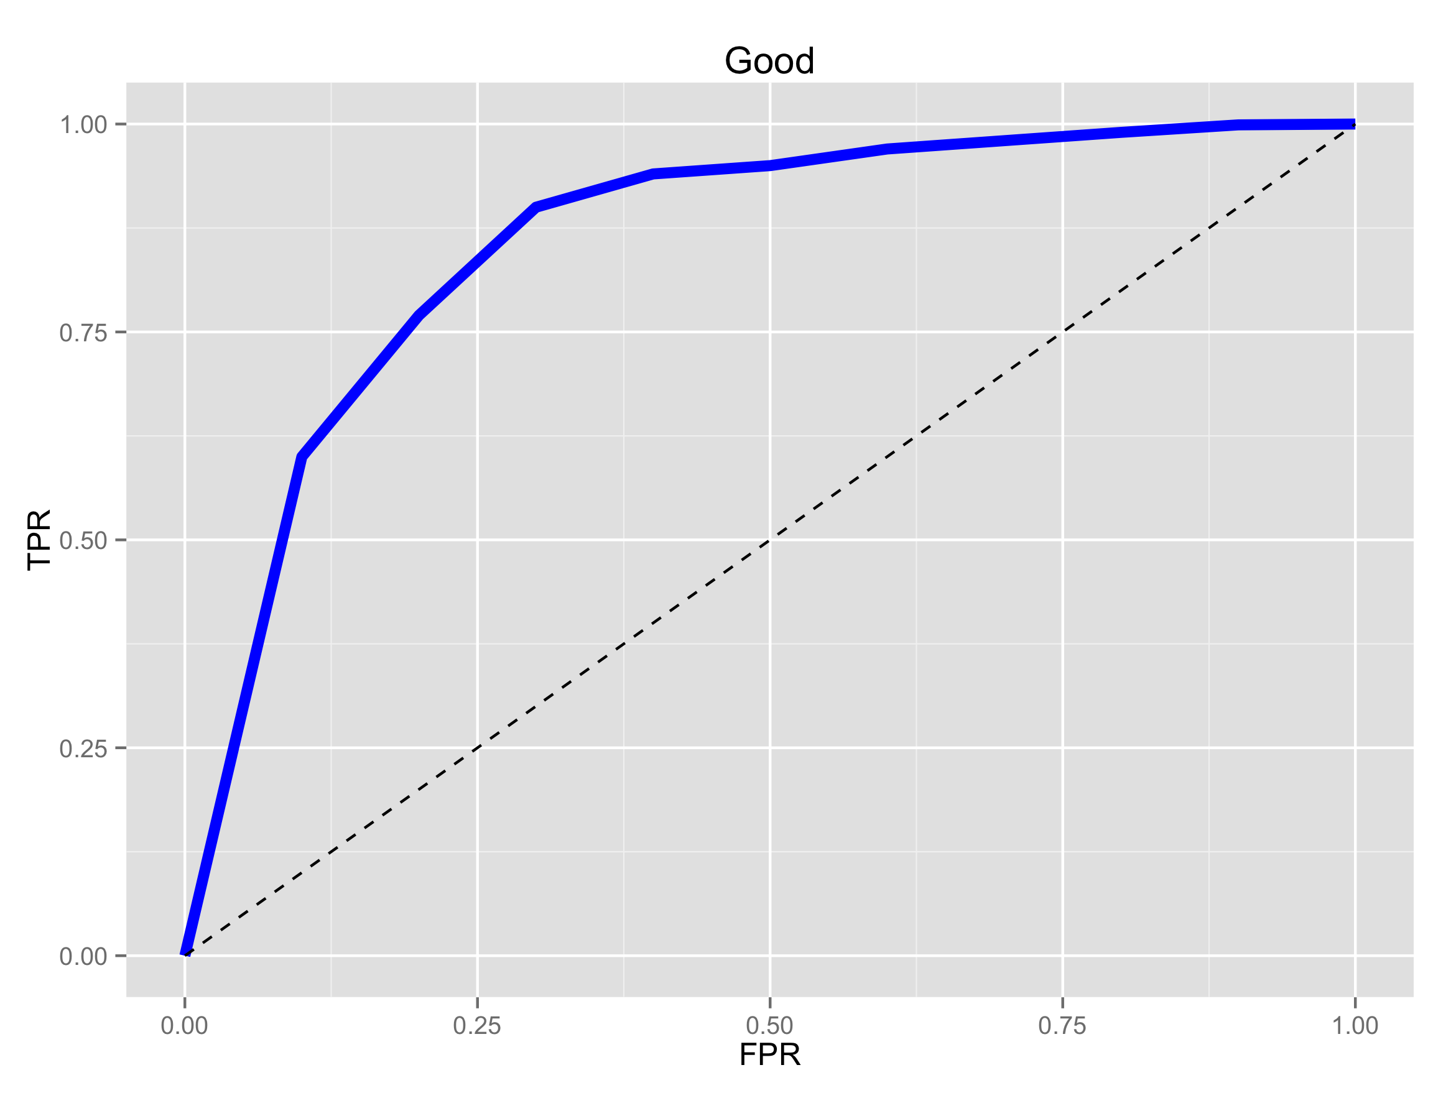
ROC Curves and AUC
Image source: http://blog.yhathq.com/posts/roc-curves.html

Slide 23
Session Two -- Text
Natural Language Processing
Natural Language Generation
Natural Language Understanding (ish)
Markov models, word2vec

Slide 24
Word2Vec Twitter Bot
Pick a body of knowledge to learn (corpus)
Represent that knowledge to the machine
‘One-hot’ representation of knowledge
What does a word vector mean?
The basis for all training: N-Grams

Slide 25
Hands on Example
Look at the ‘mnist’ directory
Run in this order:
Word2Vec Timing (3m 28s on my machine)
Twitter Chatbot (silly demo)
Word2Vec (for exploring the API)

Slide 26
Evaluating Data - Visual
Scatter Plot
Heap Map
Geographical Overlay
Time Views

Slide 27
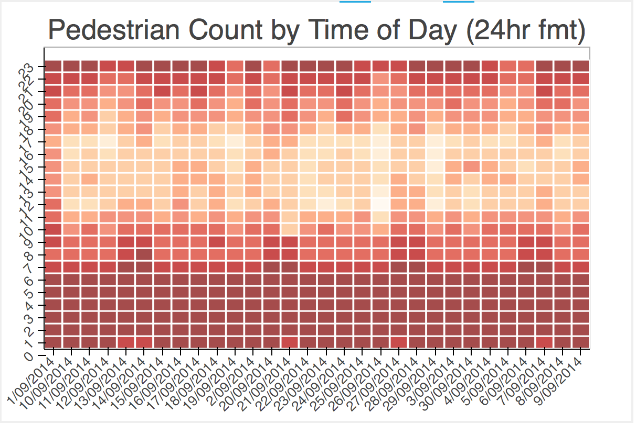
Heat Map
Image by the author: CC-BY

Slide 28
There are still some problems
The future may not be like the past
In predictable ways
In unpredictable ways
Obviously
Not-so-obviously
Nothing beats a causal explanation – what is the actual method of operation?
Same as saying – break the problem down

Slide 29
Solving New Problems
Theoretical approach: translate to another known problem to prove performance
Baseline against random forest
More attention needed on input biases
More attention needed on evaluation
Visualise All The Things

Slide 30
Directions in Data Science
Adverserial Examples
Automated Discovery of Solutions
Deep Dreaming (just cool, reveals biases)
Advanced Visualisation
Integration of Systems and Knowledge
That just leave the data munging… ☹

Slide 31
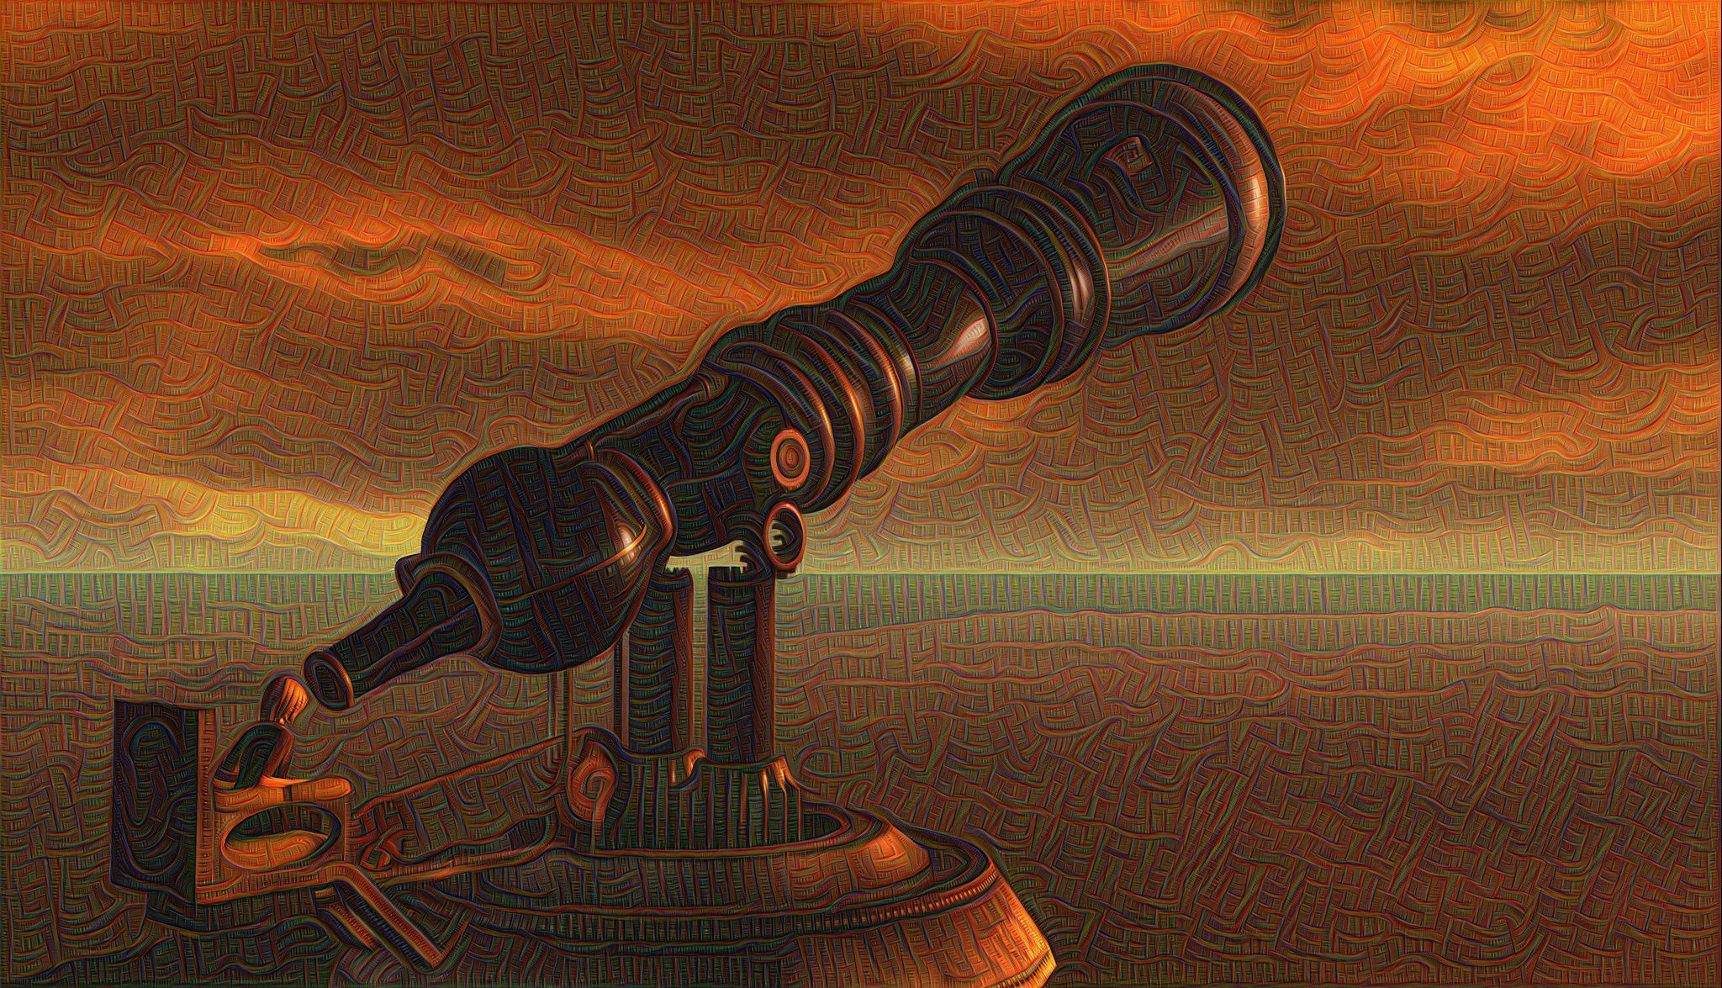
Deep Dreaming
https://www.flickr.com/photos/botgirlq/19810455170/ CC-BY-NC 2.0

Slide 32
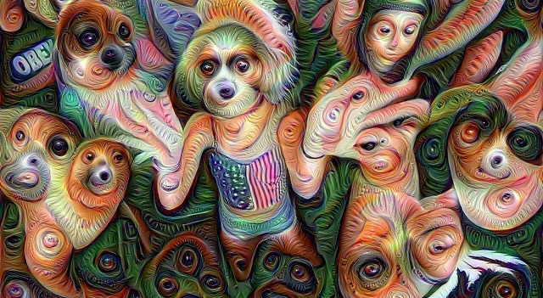
Deep Dreaming
https://www.flickr.com/photos/pagedooley/19687972695/ CC-BY .20

Slide 33
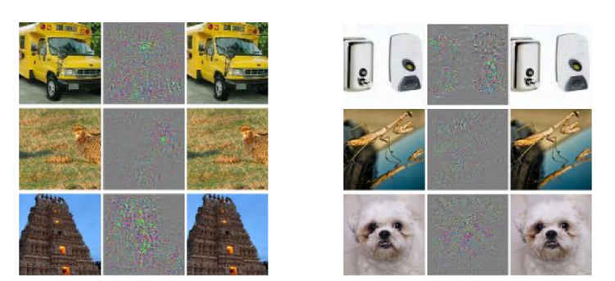
Adverserial Examples
Image source: http://arxiv.org/pdf/1312.6199.pdf

Slide 34
References
http://arxiv.org/pdf/1301.3781.pdf: a paper
http://arxiv.org/pdf/1312.6199.pdf: a paper
https://www.youtube.com/playlist?list=PL6Xpj9I5qXYEcOhn7TqghAJ6NAPrNmUBH ← this is the best machine learning lecture series, by Hugo Larochelle.
http://www.r2d3.us/visual-intro-to-machine-learning-part-1/ oh so very shiny

Slide 35
Exciting things to try
https://studio.azureml.net/
https://www.kaggle.com/
http://deeplearning.net/category/news/

